Slide 1
SUBJUNCTIVE
subiungo, subiungere, subiunxi, subiunctus =join in, unite
subject

Slide 2
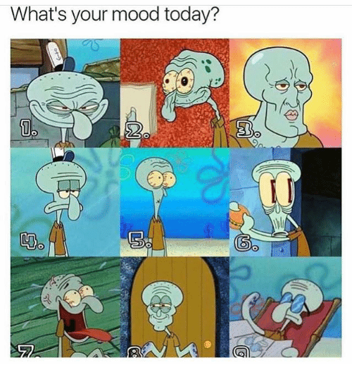
Subjunctive is one of the 3 verbal moods:
Indicative – factual mood
Imperative- commanding
Subjunctive- potential, unreal, hypothetical

Slide 3
INDICATIVE shows facts
My cat is hungry.
I made lunch.
It will rain tomorrow.

Slide 4
IMPERATIVE gives an order/command
Bring some water!
Wash your hands!
Do not lean on the window!

Slide 5
SUBJUNCTIVE variety of nonfactual ideas
Expresses some uncertainty, possibility, desires..
Indicative Subjunctive
We are walking. Let us walk. (exhortation)
She will come. If only she would come! (wish)
We are going to the We might go to the theater tonight. (potentiality)
theater tonight.
In Latin sentences on the right would all be in the subjunctive mode because the writer or speaker wishes to represent these actions as nonfactual.

Slide 6
Out of Latin 6 tenses:
Present stem (found in infinitive/2nd principal part):
present, imperfect, future
Perfect stem (found in perfect/3rd principal part:
perfect, pluperfect, future perfect
Only 4 tenses have subjunctive mood:
Present, imperfect, perfect, pluperfect

Slide 7
USES OF SUBJUNCTIVE
Subjunctive can be used in independent clauses and also in subordinate clauses.
We will talk today about subordinate clauses with conjunction cum.

Slide 8
Subordinate clauses with the conjunction cum also use subjunctive if the action happened in the past
This cum is called circumstantial cum and it is translated
“(under the circumstances) when”

Slide 9
IRREGULAR VERBS SUBJUNCTIVE
ESSE
IMPERFECT SUBJUNCTIVE PLUPERFECT SUBJUNCTIVE
ESSEM FUISSEM
ESSES FUISSES
ESSET FUISSET
ESSEMUS FUISSEMUS
ESSETIS FUISSETIS
ESSENT FUISSENT

Slide 10
Pluperfect subjunctive is made from the perfect stem + endings: sg. pl. issem issemus isses issetis isset issent
Cum Strythio et Modestus ad pontem venissent, equus transire noluit.
(Under the circumstances) when Strythio and Modestus had arrived at the bridge, the horse did not want to cross it.
Cum Strythio transiisset, equus transire etiam tum nolebat.
(Under the circumstances) when Strythio had crossed, even then the horse was not wanting to cross.
The subjunctive is always translated in English as an indicative. SUBJUNCTIVE:
Made from perfect
stem + endings:
issem

Slide 11
Imperfect subjunctive: infinitive + personal endings: -m -mus -s -tis -t -nt
Imperfect subjunctive with the cum clauses:
Look at this example:
Cum ad Romam venirem, multas homines in vias fuerunt.
When I was arriving to Rome, many men were in the streets.
Iuvenis, cum librum legeret, magnum clamorem audivit.
Young man, when/while he was reading a book, heard a big noise.

Slide 12
Practice subjunctive imperfect and pluperfect
Cum gladiatores leonem interfecissent, spectatores
plauserunt.
______________________________________________________________________________________________________________________
___________________________________________________________________________________________________________________
Sorores, cum culinam intravenissent, pocula sordida
lavāre coeperunt.
______________________________________________________________________________________________________________
_______________________________________________________________________________________________________________

Slide 13
Practice subjunctive imperfect and pluperfect
Cum Quintus et Dumnorix ad ultimas partes insulae contenderent, milites Dumnorigem per oppidum frustra quaerebant.
____________________________________________________________________________________________________________________________________________________

Slide 14
Practice subjunctive imperfect and pluperfect
Cum hospites cenam consumerent, fur cubiculum intravit.
________________________________________________________________________________________________________________________________

Slide 15
IMPERFECT SUBJUNCTIVE PLUPERFECT SUBJUNCTIVE
SORT OUT THE IMPERFECT
AND PLUPERFECT SUBJUNCTIVES:
Deleret
Audivissemus
Scriberetis
Effugisses
Agitarem
Cogitaremus
Dedisset
Amavissetis
_____________
_____________
_____________
____________
_____________
_____________
_____________
_____________

